Slide 1
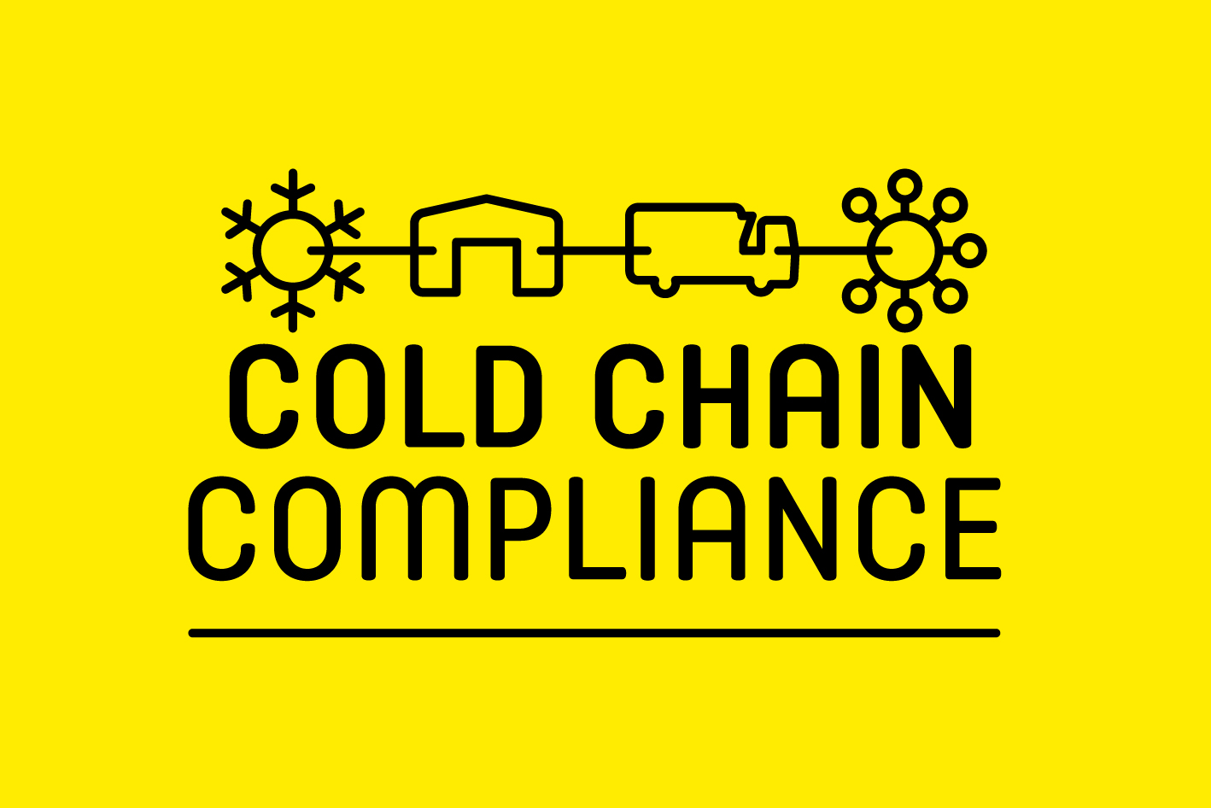

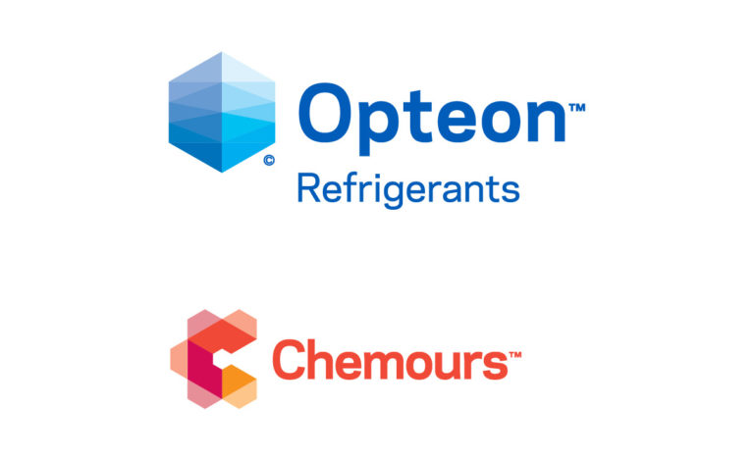
Webinars for Cold Chain Professionals
COMPLIANCE WEEK DAY 2: THE FUTURE OF REFRIGERANTS
STARTING AT 10:30AM
Supported by:

Slide 2


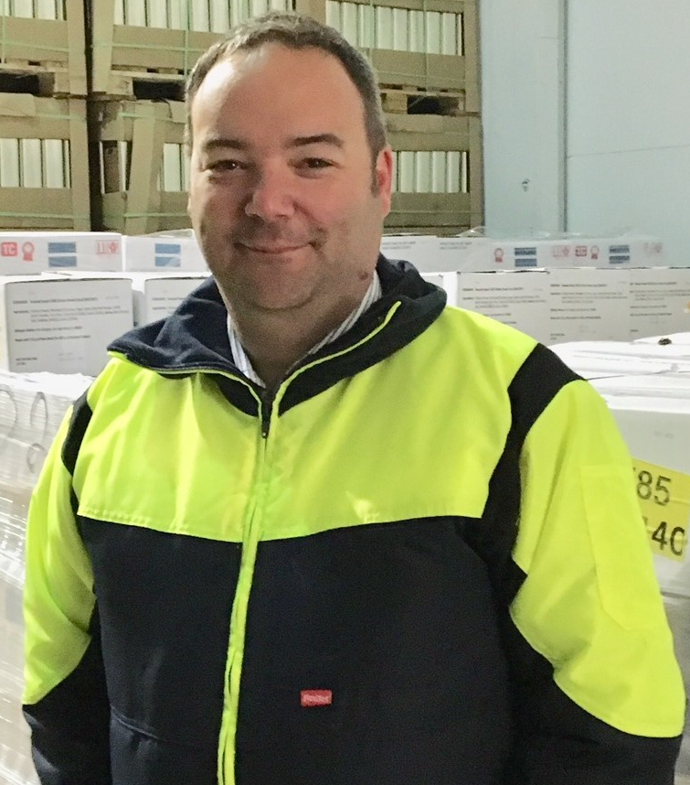
TOM SOUTHALL
POLICY DIRECTOR
COLD CHAIN FEDERATION
SHANE BRENNAN
CHIEF EXECUTIVE
COLD CHAIN FEDERATION

Slide 3
DAY 1
THE FUTURE OF REFRIGERANTS

Slide 4


SCHEDULE
10:30 – 10:35 | Introduction
10:35 – 10:55 | Future of Refrigerants: a policy update
11:00 – 11:20 | The evolution of low GWP refrigerants
11:20 – 11:40 | Adapting Refrigeration Systems for new refrigerants
11:40 – 11:55 | Questions & Discussion | With: Shane Brennan

Slide 5
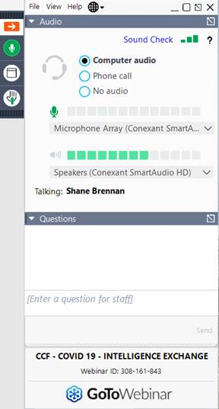

Slide 6

THE FUTURE OF REFRIGERANTS: POLICY UPDATE
GRAEME FOX
HEAD OF TECHNICAL, BESA AND REFCOM

Slide 7


The Future of Refrigerants
Graeme Fox
Head of Technical
at
BESA and REFCOM

Slide 8
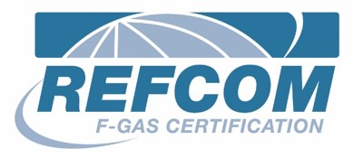
The F-Gas Phase Down
Steps determined by CO₂ tonnes equivalent value.
Average GWP show the limitations our sector will face in the coming years.
We currently have half the gas available (in terms of CO₂ eq) than we did 6 years ago.

Slide 9
The F-Gas Phase Down
The now familiar F-Gas Phase Down steps diagram:
What happens now we have left the EU?
How is the quota split?
GB Regulations rather than UK?

Slide 10
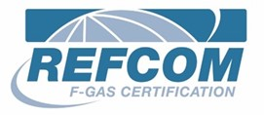
Brexit implications for the sector
Virgin Refrigerant
From Northern Ireland to and from the UK
Requires QUOTA to move.
Essentially obtain your refrigerant and any item that CONTAINS refrigerant in Northern Ireland.
DO NOT transport between the UK and Ireland.

Slide 11
The F-Gas Review – what can we expect?
EC517/2014 revision proposals expected
Q1/2 2022
The pre-charged splits argument rearing up again?
Upskilling / Re-training? Flammable refrigerant use.
Illegal cylinders and imports not on quota?
Will the UK follow suit or go further?

Slide 12
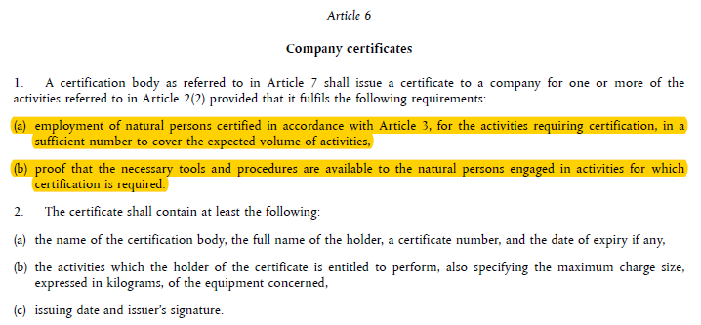
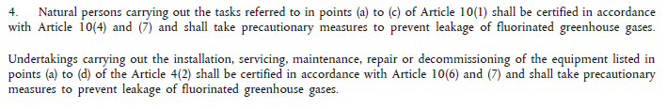
Who can the certification bodies give a certificate to?
All certification bodies are bound by implementing regulation 2067/2015 where it states in Article 6 that only companies who employ properly certified engineers / technicians can be given a valid company F-Gas certificate.
And F-Gas EC517/2014 Article 3 states that only certified people can carry out any installation, servicing, maintenance, repair or decommissioning work

Slide 13
Who can the certification bodies give a certificate to?
All certification bodies are bound by implementing regulation 2067/2015 where it states in Article 6 that only companies who employ properly certified engineers / technicians can be given a valid company F-Gas certificate.
And F-Gas EC517/2014 Article 3 states that only certified people can carry out any installation, servicing, maintenance, repair or decommissioning work

Slide 14
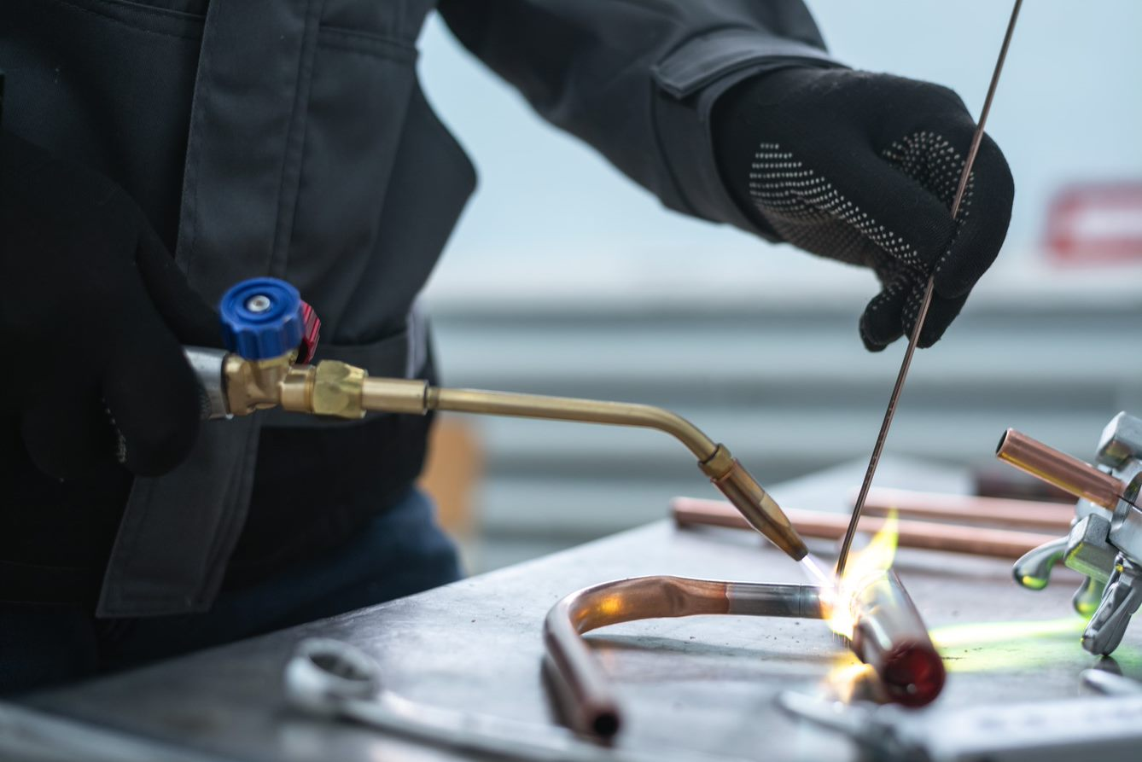
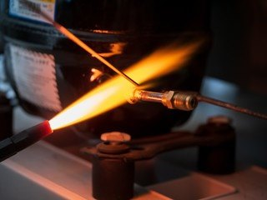
Are practical skills adequate?

Slide 15

Are practical skills adequate?
thebesa.com/academy/f-gas-renewal
Soon to incorporate the ACRIB Flammables module

Slide 16
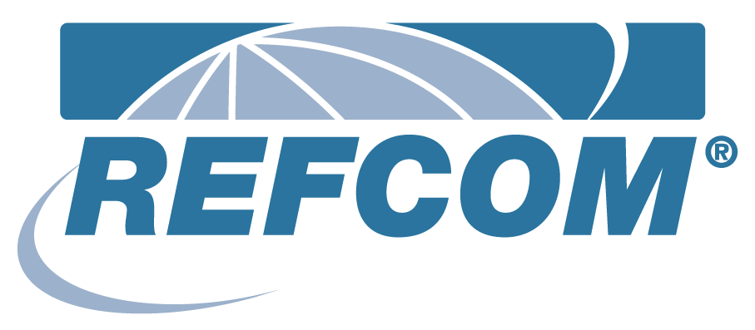
The F-Gas Phase Down
There is now 55% less refrigerant placed on market than in 2015
We are now in a situation where the total refrigerant placed on the market annually has an average GWP of no more than 900 just to maintain the status quo.
Growth in the market creates a bigger problem.
If we increase the number of systems in use then that figure needs to be even lower!

Slide 17
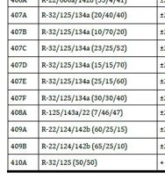
Extract from EN378-1-2016 Annex E
The 4-series of refrigerants that we want use as alternatives to 404A all contain R32 to some extent:
Between 10 and 30% for the commercial refrigeration alternatives….

Slide 18
Refrigerant Options: small to medium duty
Refrigerant Number | Toxicity | Flammability | GWP
32 | A | 2L | 675
134A | A | 1 | 1430
290 | A | 3 | 3
407C | A | 1 | 1774
410A | A | 1 | 2088
600 | A | 3 | 4
600a | A | 3 | 3

Slide 19
Refrigerant Options: small to medium duty
Refrigerant Number | Toxicity | Flammability | GWP
32 | A | 2L | 675
134A | A | 1 | 1430
290 | A | 3 | 3
407C | A | 1 | 1774
410A | A | 1 | 2088
600 | A | 3 | 4
600a | A | 3 | 3
High flammability make these unsuitable for building services
Strict limitations on charge size under EN378-2016

Slide 20
Refrigerant Options: small to medium duty
Refrigerant Number | Toxicity | Flammability | GWP
32 | A | 2L | 675
134A | A | 1 | 1430
290 | A | 3 | 3
407C | A | 1 | 1774
410A | A | 1 | 2088
600 | A | 3 | 4
600a | A | 3 | 3
Medium GWP make these unsustainable for smaller systems because of the need to limit average overall GWP in accordance with the phase down targets

Slide 21
Refrigerant Options: small to medium duty
Refrigerant Number | Toxicity | Flammability | GWP
32 | A | 2L | 675
134A | A | 1 | 1430
290 | A | 3 | 3
407C | A | 1 | 1774
410A | A | 1 | 2088
600 | A | 3 | 4
600a | A | 3 | 3
The only realistic (currently available) option for small to medium duty systems
Still 275 above the target average by 2030!

Slide 22
Refrigerant Options
Refrigerant Number | Toxicity | Flammability | GWP
32 | A | 2L | 675
134A | A | 1 | 1430
290 | A | 3 | 3
407C | A | 1 | 1774
410A | A | 1 | 2088
600 | A | 3 | 4
600a | A | 3 | 3
The only realistic (currently available) option for small to medium duty systems
Still 275 above the target average by 2030!
It is classed as “mildly flammable” A2L so there are still charge restrictions under EN378-2016

Slide 23


Questions?
Thank you
Any questions?
Graeme Fox
g.fox@refcom.org.uk
Graeme.fox@thebesa.com

Slide 24
LOW GWP REFRIGERANTS
MARK HUGHES
Business Development Manager EMEA,
Chemours Thermal and Specialized Solutions

Slide 25

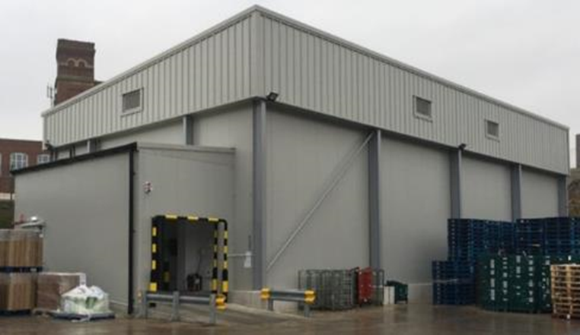



"Refrigerants ready now for the Future”- low GWP A2L refrigerants and their application
Mark Hughes MInstR
Business Development Manager EMEA
Chemours Thermal and Specialized Solutions
mark.hughes@chemours.com
Public

Slide 26



The industry needs help!
Over the next few years, most new refrigeration systems installed in the UK will have a refrigerant that is either:
Explosive,
Toxic
Or
Flammable to some degree

Slide 27

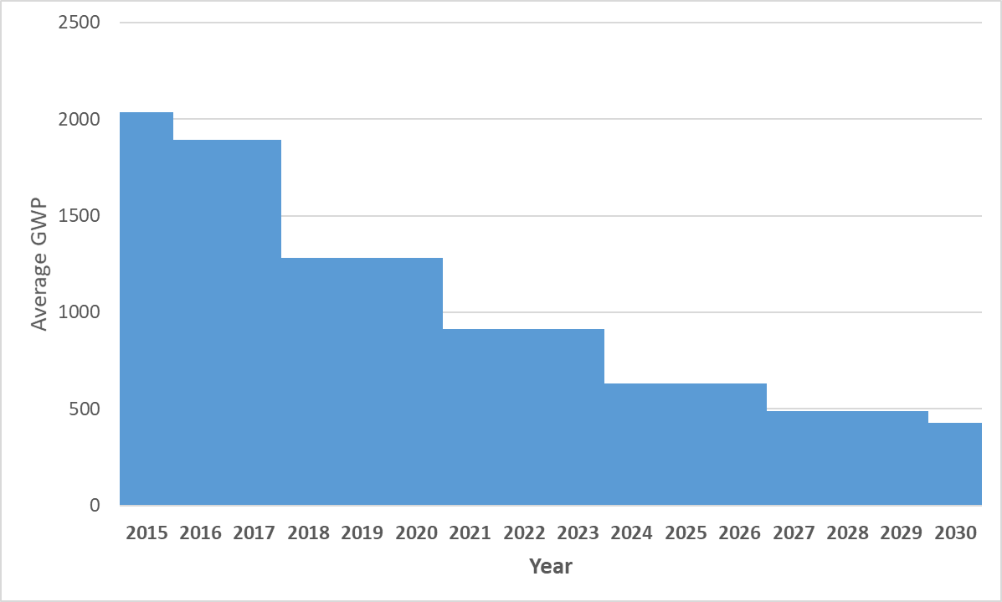
Riding The Rapids – The Phase Down
Refrigerant | GWP (AR4) | ISO 817 Safety Class
R-449A Opteon™ XP40 | 1397 | A1
R-32 | 675 | A2L
R-513A Opteon™ XP10 | 631 | A1
R-454B Opteon™ XL41 | 466 | A2L
R-454A Opteon™ XL40 | 238 | A2L
R-454C Opteon™ XL20 | 148 | A2L
R-410A
~2000
R-407F
~1900
R-407C
R-134a
R-449A
~1300
~900
R-32
R-513A
~600
R-454B
~500
~400
R-454A
R-454C
GWP Limits
 | GWP Limit
New | 2500
Service | 2500 > 10kg 404A
 | GWP Limit
New hermetic & new multi compressor commercial >40kW | 150
Primary of cascade in new multi compressor commercial >40kW | 1500
January 26, 2022

Slide 28
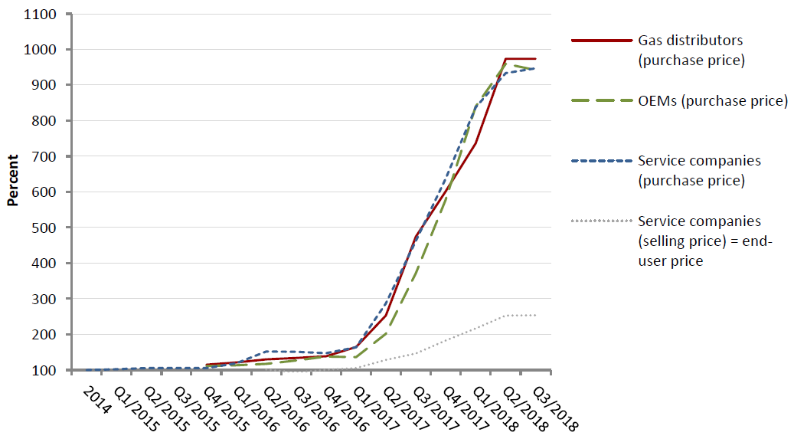


Market Drivers - Current product availability and price
  2018 showed what can happen when quota bites
  Virgin 404A ban started
  Reclaim 404A can be used but stocks required for whole of EU
  Replenish of Reclaim dependent on retrofit or replace existing systems
  many R404A systems have not been retrofitted or replaced yet
  2021, 2024 major UK quota cuts – UK enforcement working

Slide 29
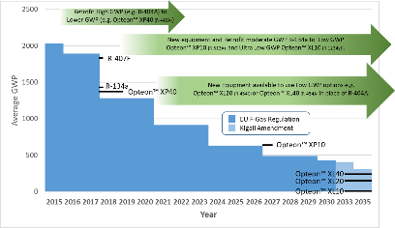
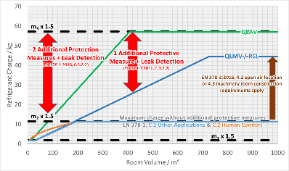
Market Drivers – Sustainability & Safety in Use
Sustainability
  Secure solution for the future (F-Gas, Kigali)
  Very low GWP products, once below 300 GWP the climate impact is all about energy performance.
Safety in use
  Proven safe to use
  A2L Charge sizes >50kg allowed under EN378
  Larger charge sizes possible with appropriate risk assessment

Slide 30
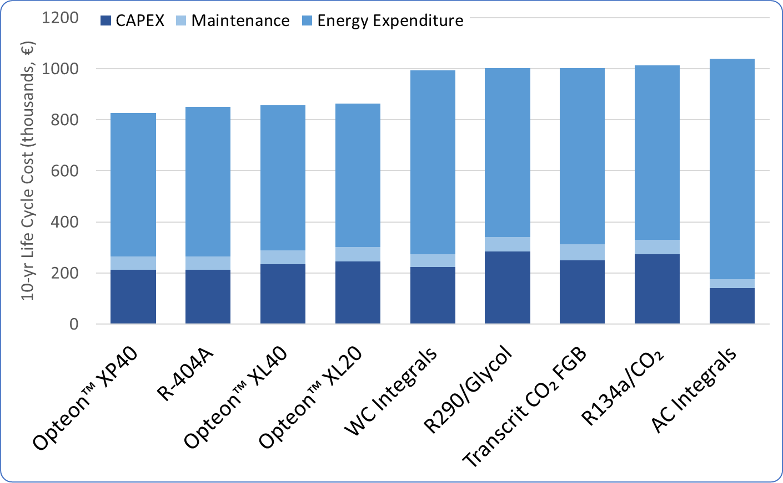
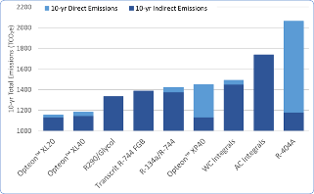
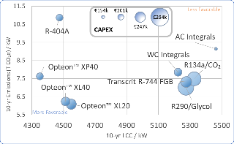
Market Drivers – CAPEX & Life Cycle Cost
  The Phasedown will prevent the installation of High GWP Refrigerants. For New Installs End Users Must Consider:
  Availability and cost (initial & ongoing) of new technology
  Energy performance – Energy efficiency is a key decision factor
  Ease of design, installation and maintenance
  Example – Cold storage

Slide 31
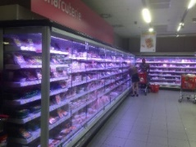
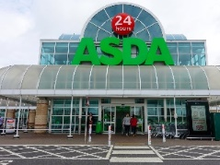
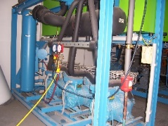
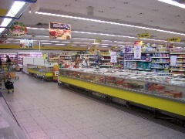
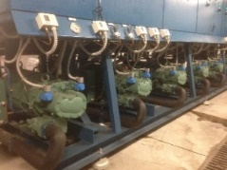
What Do I need from my New Refrigeration System?
Alternative technology choice will depend
on a number of factors including:
Cost – Lower CAPEX, Lower OPEX, Lower 10-year Life Cycle Cost
Energy Efficiency – Lower Operating Costs, Lower Indirect Emissions
Reliability - Maximum System Availability, Lowest Impact to Trade
Safety - Lower Flammability, Lower Operating Pressures
Environmental Sustainability –Legislation Compliant / Lower Total Emissions
System Complexity – Ease of Installation, Ease of Maintenance, Lower Costs

Slide 32

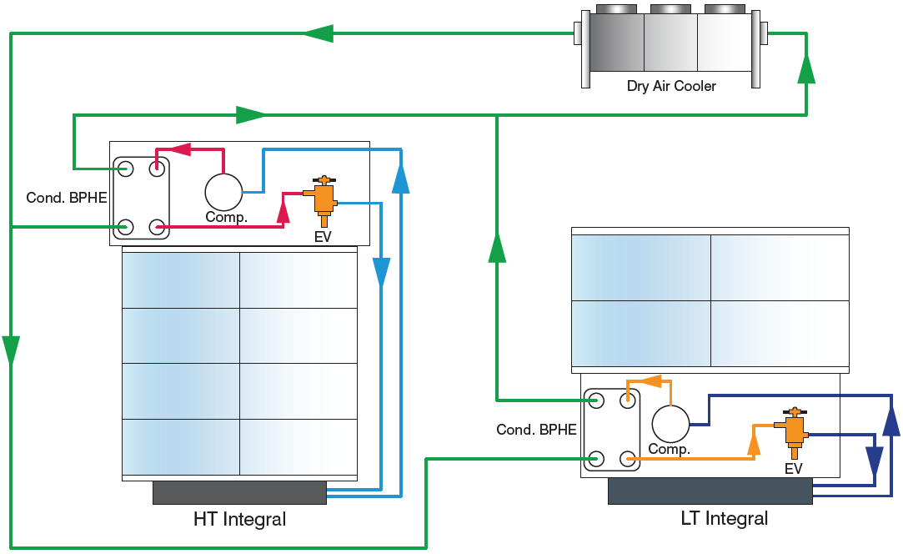
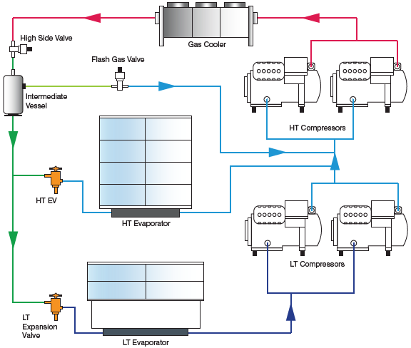
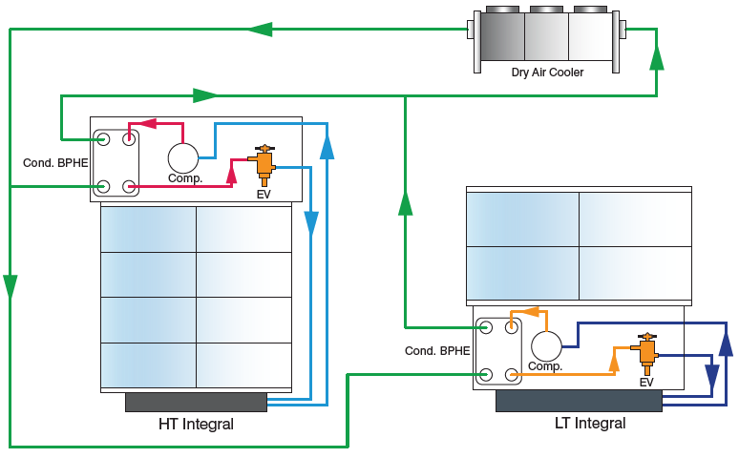
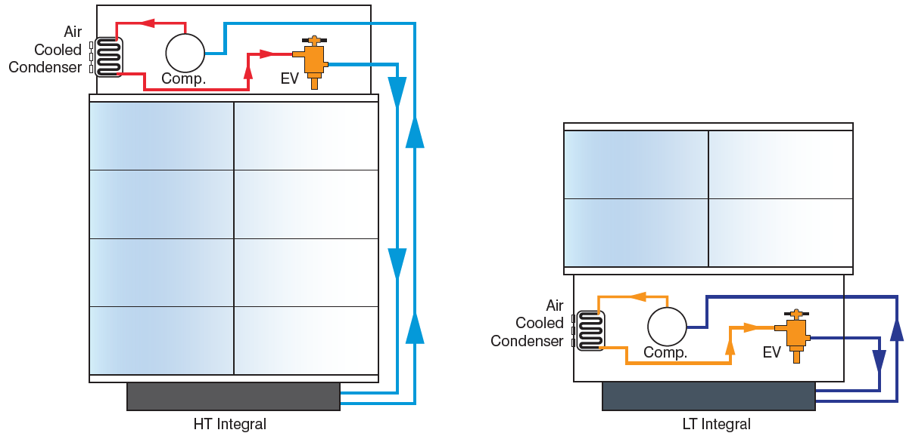

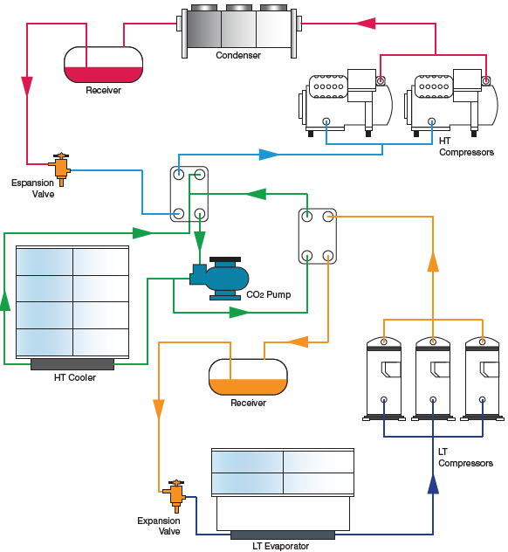
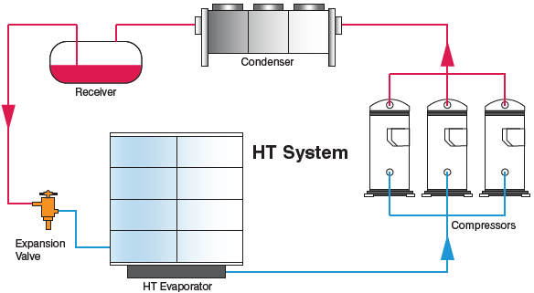
Why should I choose A2L refrigerants?

Slide 33
Can so-called “naturals” be used to meet F-Gas and Kigali targets?
They are part of the solution YES……….but there are limits:
Not possible/practical for retrofit, top-up of installed systems.
Have constraints for range of new equipment use – safety, cost, codes/standards.
Limited industry capacity & skilled contractors for installed base replacement suitable equipment.
“Natural” refrigerants | Use constraints | Market Use
CO₂ | New systems only. Retrofit not possible (high pressure). Cost and efficiency compared to latest HFO blend technology. | Good choice for supermarket low T in cascade with HFC for med T – centralized systems
hydrocarbons | New systems only. Very small charge size only; retrofit not allowed (highly flammable; codes/standards). | Common choice for hermetically sealed small refrigeration/freezing equipment. Typically used with a glycol loop for larger applications
ammonia | New systems only; retrofit not allowed (flammable, toxicity, codes/standards). Non-public areas. | Common for industrial refrigeration but not for all locations and smaller units
xx
Lower GWP HFO blends are required

Slide 34

Phase down: Opteon™ XL portfolio
High
Refrigeration
A/C and HP
R-404A
(GWP 3940*)
R-410A
(GWP 1920*)
OpteonTM XP44
R-452A
(GWP 1945*)
2017 -> average GWP:1900
Global Warming Potential
(GWP)
OpteonTM XP40
R-449A
(GWP 1282*)
R-134a
(GWP 1300*)
OPTEONTM XP SERIES
Retrofit / New systems
R-32
(GWP 677*)
2021 -> average GWP:900
OpteonTM XP10
R-513A
(GWP 573*)
OPTEONTM XL SERIES
New systems
OpteonTM XL41
R-454B
(GWP 467*)
Very low
OpteonTM XL40
R-454A
(GWP 238*)
2030 -> average GWP:400
*GWP values based on AR5
OpteonTM XL20
R-454C
(GWP 146*)
OpteonTM XL10
R-1234yf
(GWP <1*)

Slide 35
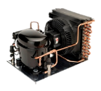
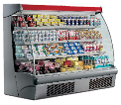

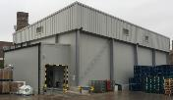
Refrigeration – Opteon™ XL Product Portfolio
Opteon™ XL, A2L low GWP solution vs. CO2 and propane
Refrigeration Applications
Opteon™ XL10 (R1234yf) GWP = 4
Replaces R-134a
Hermetic equipment and DX multi compressor Retail
Refrigeration packs and condensing units
R454C Opteon™ XL20 GWP = 148
Non-hermetic DX multi compressor Retail
Refrigeration packs <40kW and all other non-hermetic, non-retail systems
R454A Opteon™ XL40 GWP = 238

Slide 36
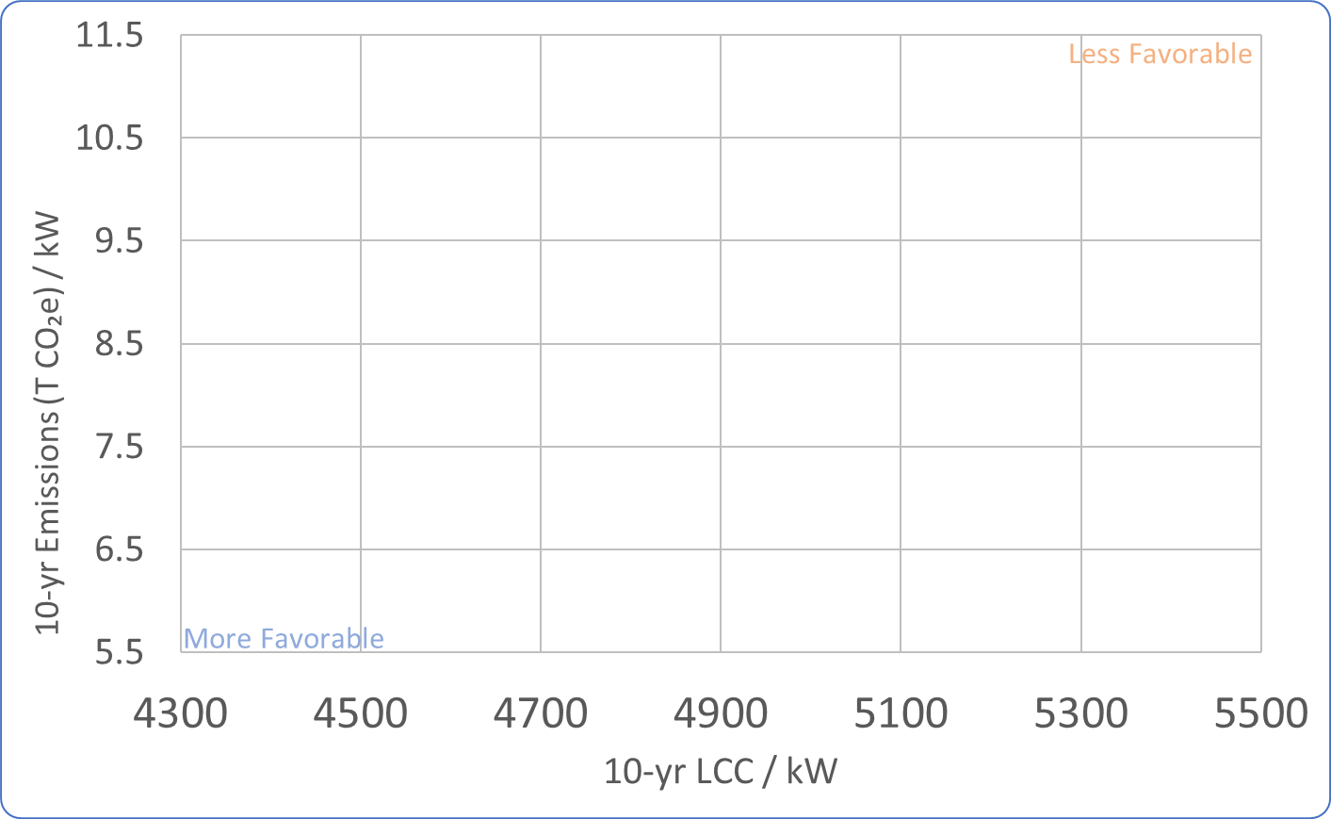
Which Technology offers the Best Value for Money?
(Standard Supermarket, 2000m²)
Leicester, UK
€154k
€201k
€247k
€294k
R-404A
CAPEX
Air Cooled
Integrals
Water Cooled
Integrals
Opteon™ XP40
R-134a/
R-744
Baseline Emissions Reduction = Opteon™ XP40 Emissions
Transcritical R-744 Booster
Opteon™ XL40 (R-454A)
Opteon™ XL20 (R-454C)
R-290 / Glycol
û
AC & WC Integrals - Highest emissions and High 10-yr LCC.
Transcritical R-744 System - Only 4% lower than baseline in the moderate UK climate at a High 10-yr LCC.
Secondary Loop Technologies - Emissions 2-8% below baseline with increased 10-yr LCC of 21-22%.
Highest CAPEX of all technologies.
Opteon™ XL Refrigerants – Largest Emissions Reduction (18-20% less than baseline), Lowest 10-yr LCC (16-21% lower than other Low GWP options)
û
û
ü

Slide 37

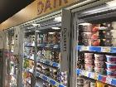
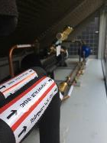
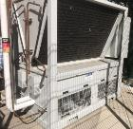
Applications - Retail
  Commercial Refrigeration
  ASDA modular approach
  Small packs and condensing unit end users <40kW
  Chains of small supermarkets and convenience stores
  Large end users with small format stores – Local, Express, PFS
  Click and collect Cold stores
  A2L refrigerants proven to be safe in this application

Slide 38
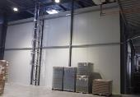
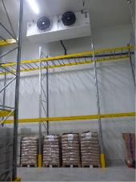


Applications – Commercial non-retail
  Cold stores
  Smaller facilities not suitable for ammonia and CO₂ is not efficient
  Condensing unit and small pack non-retail
  Food production, storage
  Can use >150 GWP
  Similar to traditional HFC technology but very low GWP –
  experienced installer/contractor friendly
  A2L refrigerants proven to be safe in this application

Slide 39





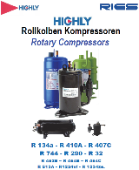



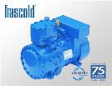
Component OEMs Progress for Refrigeration
Many Components for A2L including Opteon™ XL are now available from OEMs
Widespread Commercial availability through wholesale chain
Public

Slide 40
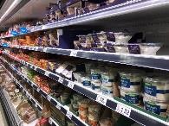

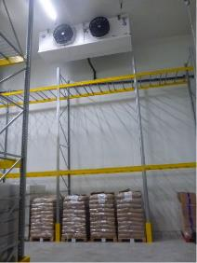

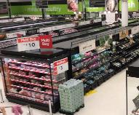


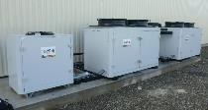
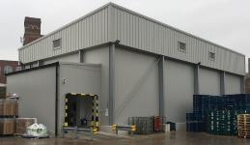
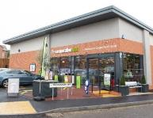
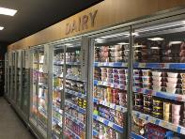



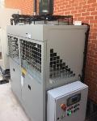

Widespread adoption
October 2019
A2Ls are already widely used for Air Conditioning
For Refrigeration
Numerous A2L systems
have already been installed in
Save money, Live better.
Retail
&
Non-Retail
Opteon™ XL40
Opteon™ XL40
September 2019
Opteon™ XL20 &
Opteon™ XL10
October 2019
Opteon™ XL20
September 2017

Slide 41






Commercial Refrigeration
MCE Store converted to Opteon™ XL40 in January 2018
Operated for 5 months with good system stability
Indications of Good Energy Performance
A2L Ready Pack Installed in New MCE August 2018
Emerson Opteon™ XL40 approved Scroll Compressors
Hubbard Pack
Installed by City Building Engineering Services
System in a “Real” Store Installed October 2019
F-Gas Compliant
94% Lower GWP than R-404A
Improved Energy Efficiency over R-404A and R-448A
Lower Capital and Maintenance Costs than CO₂ system

Slide 42





Opteon™ XL40 – Park Cake Bakeries, UK
Freeze Store (-18ºC)
Cold Store Dimensions: 24m x 11.9m x 6.4m
Capacity 360 Pallets
3 x Zanotti HCU5180B941J Condensing Units
Bitzer Compressor 4HE-18Y-40P, BSE 32 Oil
23 kg Refrigerant per Unit
Designed and installed by Dawson rentals
Dawson portable chill and freezer stores
moving from R449A to designs on Opteon™ XL40 R454A
Public

Slide 43





Industrial Refrigeration – Technofroid, France
Main Cold Room 401m² (3011m³ Volume)
  Room temperature -25°C approx. (T_{evap} =-30°C, T_{Cond} = 45°C)
  Two LT systems are used – 36 kg R-454C (per system)
  Cooling capacity per system 25 kW
  Each system is using a Bitzer compressor (6FE-44Y-40P)
  Guntner evaporators (GHN 071.27/27)
  Condensers A2L AF Energy (GCC-TNF-N25-Y)
  EXV Carel E2V35
Opteon™ XL20
Entrance ‘Air-Lock’ 57m²
  Room temperature 5°C approx. (T_{evap} =-5°C, T_{Cond} = 45°C)
  One MT system – 11kg Opteon™ XL10 (R-1234yf)
  Cooling capacity 10 kW
  Bitzer compressor (4DES-5Y-40P)
  Guntner evaporator (GACC RX 040.1/2)
  Condensers A2L AF Energy (GCC-P1-SHS-8E-1EC450)
  EXV Carel E2V35
Opteon™ XL10
A heat recovery system is installed (in parallel to the condenser)
  The heat is used to heat up the floor, for sanitary hot water and space heating for the employees. This recovery systems allows tax reductions according to the French laws SWEP plate water condensers are used for this system

Slide 44
UK Cold store activity - status
  Increasing number of cold store contractors working with A2L
  Long term solution compared to R449A or R452A for new install
  Experience with equipment and installation increasing
  Components available to manufacture A2L systems
  Many projects ongoing in produce and food storage
  around the UK
  Technical support available through distributors and wholesalers
  and direct from Chemours

Slide 45




Very Low GWP, Long Term, Sustainable Solutions
OpteonTM XL
Refrigerants
“The sensible choice - right now”
Mark Hughes
Business Development Manager
Chemours Thermal and Specialized Solutions
mark.hughes@chemours.com
Opteon™ XL20
R-454C
Opteon™ XL40
R-454A
Public

Slide 46

Q & A
Thank you
Mark.hughes@chemours.com

Slide 47
ADAPTING REFRIGERATION SYSTEMS FOR CHANGING REFRIGERANTS
RICHARD PARR
ENGINEERING DIRECTOR, RYAN JAYBERG LTD

Slide 48

Refrigeration Design, Consultancy, Build & Service Company
How refrigeration systems will need to evolve to be able to use lower GWP refrigerants and aid businesses reduce carbon emissions?
www.ryan-jayberg.co.uk
Refrigeration, Cooling & Heat Pump Solutions & Services

Slide 49
About us
36 Years Trading- Independent privately owned company
Refrigeration Solutions & Services
Our HQ is in London with regional offices, Gloucester, Swansea, Southampton
Our ethos is to deliver our services with integrity & efficiency forming long term partnerships with our clients.
Passionate in low carbon technologies, their integration within the built environment & our vision is to provide clean, green refrigeration, cooling HVAC & Heat Pump technologies so we reduce our clients carbon footprint.
www.ryan-jayberg.co.uk
Refrigeration, Cooling & Heat Pump Solutions & Services

Slide 50







What do we do?
Cradle to Grave Services-
Consult, Design, Build, Maintain, Measure & Improve.
www.ryan-jayberg.co.uk
Refrigeration, Cooling & Heat Pump Solutions & Services

Slide 51
We have come full circle?
1800’s - 1929
1930’s-1940’s
1987
2016
Mechanical refrigeration used natural refrigerants. Nearly all the first-generation refrigerants were flammable, toxic or both and some were also highly reactive.
CFCs & HCFCs (Chlorofluorocarbon’s, Hydrochlorofluorocarbon’s) refrigerants were developed.
What wasn’t known at the time is that CFCs deplete the ozone layer, this was established in 1970’s
Montreal protocol signed.
Phase out and eventual ban of CFCs & HCFCs due to their ODP were replaced with HFCs (Hydrofluorocarbon’s).
Kigali Agreement signed in 2016 to reduce use of HFCs, especially high GWP refrigerants due to their effect on the climate (global warming impact).
Now
We are back to natural refrigerants? (Co2, Ammonia, Hydrocarbons) and the new generation of developed low GWP refrigerants HFO’s (HydroFluoroOlefin).
www.ryan-jayberg.co.uk
Refrigeration, Cooling & Heat Pump Solutions & Services

Slide 52
Low GWP Refrigerants
What are they?
There are over 160 single compound and blended refrigerants listed, but this easily gets narrowed down to 20-30 “available” refrigerants.
To protect against changing regulation we typically always advise the lowest GWP refrigerant be prioritised on the basis BOTH safety and efficiency measures can be satisfied for your specific application.
Refrigeration selection continually debated since commercialisation of refrigerant technology. Impact decisions-
Environmental/ legal obligations,
Safety requirements (Pressure, Toxicity, Flammability),
Efficiency and thermodynamic cycle
Material compatibility
Availability- components
Competency/ expertise- pre & post construction
www.ryan-jayberg.co.uk
Refrigeration, Cooling & Heat Pump Specialists

Slide 53
Low GWP Refrigerants
Unfortunately there is no single refrigerant that gets a green light across the board-
Refrigerant/ Generic Type | Class | Flammability | Inhalation | Pressure | Efficiency in High Ambients | Cost of Refrigerant | System Cost | Key Hazards
R744 (C02) | A1 | Non Flammable | Asphyxiant- Low Toxicity | High | Low- critical pt 31degC | Lower | Higher | Asphyxiant, High operating pressures, dry ice cause freeze burns
R717 (Ammonia) | B2L | Low Flammability | Toxic | Lower | Higher | Lower | Higher | Asphyxiant, Toxic, low flammability, dry ice cause freeze burns
HFO's (R1234ze) | A2L | Low Flammability | Asphyxiant | Similar to HFC's | Similar to HFC's | Higher but HFCs PD impact | Higher | Asphyxiant, low flammability, dry ice cause freeze burns
HC (R600a, R290, R1270) | A3 | Highly Flammable | Asphyxiant | Similar to HFC's | Higher | Lower | Higher | Asphyxiant, high flammability, dry ice cause freeze burns
www.ryan-jayberg.co.uk
Refrigeration, Cooling & Heat Pump Solutions & Services

Slide 54

The new generation- low GWP Refrigerants
With lower GWP refrigerants there is a trade-off between a lower GWP and flammability. Most of the “current” refrigerants have no simple low-GWP drop-in solutions-
Source Danfoss
www.ryan-jayberg.co.uk
Refrigeration, Cooling & Heat Pump Solutions & Services

Slide 55
HFO’s- A2L and HC’s A3 Refrigerants
The use of flammable refrigerants, clients and system designers must ensure safety;-
1) Sources of ignition on or close to leaked refrigerant cannot ignite leaked refrigerant. Simulation tests, ventilation and non sparking devices may all be required. Don’t forget where equipment is located in the open air leaked refrigerant can stagnate causing damage/ danger to property or people. Gas detection & ventilation will likely be required.
2) Refrigerant that leaks into a room/space must not pose an explosion risk. Charge sizes have to be limited. This includes assessment of all spaces including where refrigerant pipework may pass not simply where plant or evaporators maybe located.
These refrigerants will/ are being used in small close coupled condensing units & sealed systems such as mono blocks. Outdoor items such as water chiller’s/ heat pumps already adopt these refrigerants using multiple smaller refrigerant circuits to limit charge sizes.
Although BS EN 378 differentiates between types of flammable refrigerants, other regulations & standards apply-
- DSEAR applies to handling flammable refrigerants
-ATEX 95 applies.
These refrigerants can offer energy savings vs older HFC refrigerants- Safe design, risk assessment and management is an essential requirement.
www.ryan-jayberg.co.uk
Refrigeration, Cooling & Heat Pump Solutions & Services

Slide 56

HFO’s- A2L and HC’s A3 Refrigerants
Future systems need to be risk accessed to manage/ eliminate Toxicity & Flammability aspects that come with low GWP refrigerants.
Existing facilities using older higher GWP HFCs need to consider new/ additional requirements.
Restrictions on use and maximum charge sizes must be understood. This is impacted by;-
  Location of equipment, is it an occupied space or external?
  Above or below ground?
  Who has access to the area, public- unrestricted or authorised access?
BS EN 378. Table C1 – gives guidance where toxicity is dominant hazard (R717, R744)
Table C2- gives guidance where flammability is the dominant hazard (HC and A2Ls)
Source Refcom
www.ryan-jayberg.co.uk
Refrigeration, Cooling & Heat Pump Solutions & Services

Slide 57
Ammonia (R-717) Refrigeration Systems
Used in large scale industrial operations and is very efficient for both refrigeration & heating applications. This is an established efficient natural refrigerant that will play significant part in the future of large industrial systems.
Ammonia R-717
PROS OF AMMONIA SYSTEMS:
Natural and environmentally friendly- GWP 0
Energy efficient
Good heat transfer rates
Lots of development into low charge systems to improve safety
Low material/ refrigerant price
CONS OF AMMONIA SYSTEMS:
A leak could injure or kill someone in rare cases- (Toxic & Flammable in certain quantities). Odour is sign of leakage.
Usually used in warehouses and spaces with less personnel- reduce exposure (not used in public areas)
www.ryan-jayberg.co.uk
Refrigeration, Cooling & Heat Pump Solutions & Services

Slide 58
CO2 (R-744) Refrigeration Systems
CO2 was used in refrigerant systems in 1800’s. Industry moved away from CO2 towards synthetic refrigerants. Since phase down in FGases CO2 has been adopted widely especially in the commercial sector & in cooler climates.
PROS OF CO2 SYSTEMS:
Non-corrosive; non flammable; low toxicity (A1 refrigerant)*
Natural and environmentally friendly
Efficient at low temperatures
Required equipment takes up less physical space. Volumetric cooling capacity is between 5 and 8 times that of HFCs, reducing the required compressor displacement and pipe size.
Good heat recovery opportunities for hot water users
Lots of development/ technology- Transcritical Booster Systems
CONS OF CO2 SYSTEMS:
Critical point- Larger energy user in high ambient
High discharge temperatures so two stage compression for low temperature systems
Requires specially designed components & compressors due to high pressure
Leak detection systems required as In high concentrations Co2 can cause asphyxiation. Leak detection/ alarm systems are recommended to monitor PPM levels in enclosed spaces
www.ryan-jayberg.co.uk
Refrigeration, Cooling & Heat Pump Solutions & Services

Slide 59
There is no single perfect refrigerant that is all things to all users. The Coldchain will be made up of multiple
www.ryan-jayberg.co.uk
Refrigeration, Cooling & Heat Pump Solutions & Services

Slide 60



CO2 (R-744) Refrigeration Systems
Equipment is designed to achieve a nominal design point, which is the peak cooling load during the hottest expected ambient conditions. This design point can be considered as the “worst case” load condition. In reality, most systems spend very few hours per year close to this design point.
Source Real Alternatives
Co2 Transcritical Run Hours- Above 25degC – 1-2% of total annual hours
To reduce your carbon emissions look at the operation over the calendar year. Compare seasonal performance not just peak design performance.
www.ryan-jayberg.co.uk
Refrigeration, Cooling & Heat Pump Solutions & Services

Slide 61

CO2 (R-744) Refrigeration Systems
Chilled Store Facility & Dispatch- Case Study
A recent client was going to procure R449a systems, we were the only contractor to offer/ return a Co2 Transcritical solution/ system.
They asked why? On their website they had recently made a commitment to reduce carbon emissions. As part of the tender process pro’s, con’s and comparisons were requested.
As a minimum run costs comparable over the calendar year, even though Co2 uses more energy in peak summer ambient
Direct emissions significant saving due to reduced GWP
Life-cycle reductions over life of the chill store facility
www.ryan-jayberg.co.uk
Refrigeration, Cooling & Heat Pump Solutions & Services

Slide 62





CO2 (R-744) Refrigeration Systems
Optimising Efficiency and reducing carbon emissions in Co2 Transcritical Systems
Indirect:
Adiabatic systems/ Spay system- reduce air on temperatures to gas cooler equipment.
Full analysis required as there are some draw backs including water treatment, fin treatment and additional maintenance costs.
www.ryan-jayberg.co.uk
Refrigeration, Cooling & Heat Pump Solutions & Services

Slide 63


CO2 (R-744) Refrigeration Systems
Case Study-Optimising Efficiency and reducing carbon emissions in Co2 Transcritical Systems-
Direct:
Parallel compression- Use a compressor to “re-cycle” the higher un-useful flash gas at a higher efficiency than the operation of the main compressors. 10% Saving Opportunities
Multi Ejector Technology- Vapour & Liquid Ejectors within Co2 systems when combined with parallel compression are now reaching the market offering 10-20% Saving Opportunities
Source SCM Frigo/ Danfoss
www.ryan-jayberg.co.uk
Refrigeration, Cooling & Heat Pump Solutions & Services

Slide 64

CO2 (R-744) Refrigeration Systems
Case Study-Integrated Systems- Heat Recovery
Why are we throwing heat away if it can be used elsewhere in the facility and or used by others. To be truly carbon neutral and reduce emissions heat needs to be recovered?
Integration of heating & cooling system key priority.
Don’t just look at refrigeration/ cooling demands what are your heating demands?
Energy balance and thermal model, consider-
Hot Water
Space heating requirements
Underfloor heating requirements
Thermal/ Energy Storage
Load shifting from peak tariff times
Heat Reclaim realized in 4 stages:
Stage 1: Activate HR. Valve 1 open. (V3hr)
Stage 2: Raise the system pressure. With the increasing of the heating demand. The head pressure is increased consequently.
Stage 3: Stop gas cooler fans.
To allow the increasing of the heating load the gas cooler fans are stopped.
Stage 4: By-pass gas cooler.
In this way the HR exchanger becomes a total heat recovery and heating load is maximum
www.ryan-jayberg.co.uk
Refrigeration, Cooling & Heat Pump Solutions & Services

Slide 65

CO2 (R-744) Refrigeration Systems
Case Study-Integrated Systems- Ground Coupled Systems to reduce carbon emissions.
Utilise the ground as a battery to store thermal energy.
Use water as the condensing/ cooling medium in peak summer months to avoid transcritical operation (when the ground is cooler than the air)
Remove the heat from the ground during winter months using water to water heat pump for heating demands.
Source- Erda Energy & Ryan Jayberg
www.ryan-jayberg.co.uk
Refrigeration, Cooling & Heat Pump Solutions & Services

Slide 66
No matter the refrigerant- Safe, Efficient & Sustainable Refrigeration Design
Leak Reduction- Irrespective of the refrigerant it is important & a LEGAL requirement that leaks are minimised
Safety - all refrigerants are asphyxiants, many of the alternatives are flammable and R717 is toxic
Energy/ performance-leaking system has less capacity and consumes more power than a fully charged
Cost- Cost associated with refrigerant replacement, reliability and minimise consequential losses;
Carbon- Direct effect on climate change – some of the alternatives have a significant global warming potential;
Indirect CO2 emissions associated with additional power consumption
So:-
  Minimise the number of joints;
  Minimise the number of components;
  Close couple the system; keeping the refrigerant quantity as low as possible: refrigerant that is not in the system cannot leak
  Minimise the number of access points to the system and locate them where they are most useful;
  Avoid using Schrader valves, but if an access valve is absolutely necessary use a ball valve with a flare connector (and ensure it is capped when not in use);
  Ensure pipe is correctly clamped and vibration transmission is eliminated;
  Provide information:- the location of access points on the isometric drawing in the plant room;
  Design in ease of service to aid leak detection and other vital maintenance activities.
www.ryan-jayberg.co.uk
Refrigeration, Cooling & Heat Pump Solutions & Services

Slide 67
No matter the refrigerant- Safe, Efficient & Sustainable Refrigeration Design
Technical Considerations- Think and ask about good practice, optimization & integration?
Avoid assumptions, tendency will always to be cautious and over design. Agree a brief and a specification.
Building/ Coldroom fabric/ Door Air ingress- reduce heat gains. Minimise refrigeration & cooling requirements/ loads.
Minimise pressure drop’s in refrigeration pipework design
Minimise pipe routes, avoid setting, unnecessary joints, bends
Can delta T- temperature difference’s across heat exchangers be reduced, this will involve larger heat exchangers/ evaporators using more raw material at an increased capital cost but their will be a payback in operation. Rule of thumb for every 1DegC the evaporating temperature can be raised= 3% saving in plant energy consumption.
Grouping of evaporator loads, multiple system temperatures to avoid running multiple evaporators at the lowest evaporating condition.
Ensure compressor plant sizing consider not only maximum design loads but ability to match minimum/ part load operating conditions.
Smart Controls such as- Floating suction setpoints and optimization via intelligent electronic control system
Internet-of-Things- Smart Technology coming to the market
Can electric defrost/ heating systems be replaced with hot gas, glycol reclaimed from the refrigeration process.
Automatic leak detection and leak tightness
www.ryan-jayberg.co.uk
Refrigeration, Cooling & Heat Pump Solutions & Services

Slide 68
No matter the refrigerant- Safe, Efficient & Sustainable Refrigeration Design
Regulatory Considerations/ Incentives- Informed decision making?
Rules for minimum performance including energy efficiency regulations. ECO Labelling of products.
Recycling & waste targets
Check for grants, government incentives such as capital allowances to aid financing of higher cost options for ultimately more energy efficient solutions
CDM- Ensure equipment can be maintained easily to maximise energy efficiency
Adhere and comply with Regulations, PED, PSSR etc.
Follow standards & apply guidelines and good practice.
www.ryan-jayberg.co.uk
Refrigeration, Cooling & Heat Pump Solutions & Services

Slide 69

Efficient & Sustainable Refrigeration Design- look beyond TEWI?
Life Cycle Climate Performance (LCCP)
- Typically refrigeration designers are familiar with TEWI (Total Equivalent Warming Impact) to review refrigeration systems. This looks at both direct (refrigerant charge/ leakage) and indirect (electrical consumption from running) emissions of Co2 of a system.
- The key variance with LCCP is this calculation method also looks at energy embodied in product materials, greenhouse gas emissions during chemical manufacturing, and end of life disposal of the unit.
- As GWP’s of refrigerants get lower, coupled with the UK electricity grid becoming greener (more reliant on renewables) LCCP will become a more accurate way of accessing refrigeration systems for
www.ryan-jayberg.co.uk
Refrigeration, Cooling & Heat Pump Solutions & Services

Slide 70

Summary
There is no single perfect low GWP refrigerant
When moving to low GWP refrigerants you must consider safety. (Toxicity & Flammability)- Risk Assessment for the application.
When replacing legacy higher GWP refrigerants/ systems- consider the lowest GWP refrigerant for your application based on measured/ balanced approach around life cycle.
Consider natural refrigerants, R717 and R744
Adopt latest technology to maximise opportunities to reduce energy
Remember good practice, leak reduction, optimization & integration
“We have made a firm commitment to assist our clients in reducing their carbon footprint to provide a sustainable pathway for now & future generations. Our services & ideas, using low carbon refrigeration technologies will help build clean and green buildings and systems.”
Richard Parr- Engineering Director- MInstR, BSc
richard.parr@ryan-jayberg.co.uk
Mobile= 07969661245
www.ryan-jayberg.co.uk
www.ryan-jayberg.co.uk
Refrigeration, Cooling & Heat Pump Solutions & Services

Slide 71

QUESTIONS & DISCUSSION
With: SHANE BRENNAN
CHIEF EXECUTIVE, COLD CHAIN FEDERATION

Slide 72


GUIDANCE
FOOD SAFETY IN THE COLD CHAIN
All free to download at: www.coldchainfederation.org.uk

Slide 73

THANK YOU

